Slide 1

Serial Peripheral Interconnect Bus
(SPI Bus)
What is SPI Bus and what it is used for ?
SPI Bus characteristics, protocols, data formats
Typical SPI devices
Example device protocols
Sample Chips and Command
©Paul Davies. Not to be copied, used, or revised without explicit written permission from the copyright owner.
This lecture may contain animations and is best viewed as a slide show

Slide 2
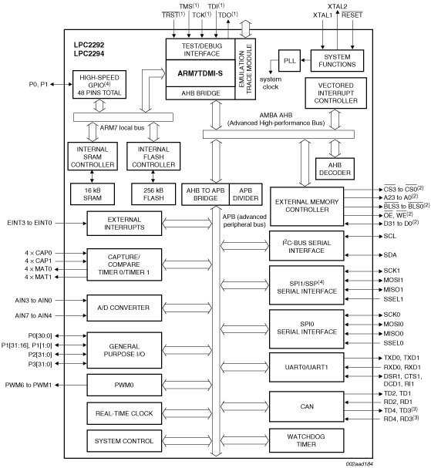
LPC2294 ARM Core from Phillips with SPI bus Controller
Dual SPI Serial Bus Controllers

Slide 3
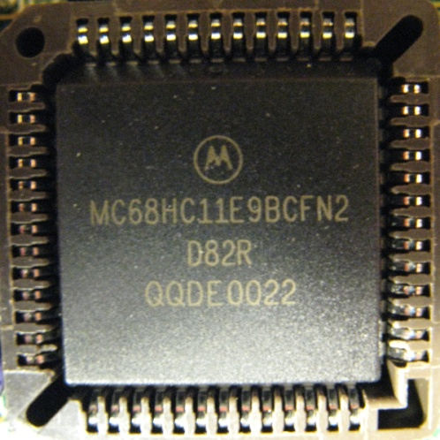
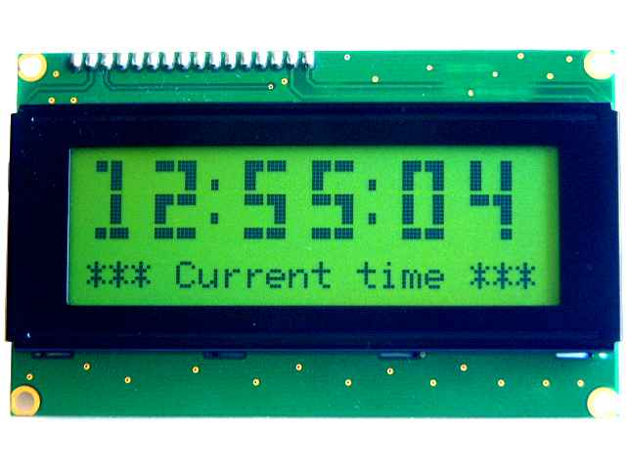
What is SPI?
A serial bus rival to I²C, designed by Motorola for use in MC6811 microcontroller.
Faster and easier to use, but not as sophisticated.
Most microcontrollers now have it built in (e.g. see page 2)
Communications uses four-wires :-
  SCLK - Serial Clock
  MOSI - Master Output, Slave Input
  MISO - Master Input, Slave Output
  SS - Slave Select (device enable, 1 per slave)
SCLK
SS
MOSI
MISO
Master
Slave Device

Slide 4
Comparison of SPI to I²C Bus
Single master only. No multi-master or arbitration protocol.
No acknowledgement sent during data transfers. Master will thus not know if a Slave device is listening (or even present).
No clock stretching to slow down data rate. Slave devices have to keep up (speed wise) or communication fails.
Individual slave devices are selected via individual slave select (SS) signals unlike I²C’s scheme of broadcasting a physical slave device address.
Slave devices have tri-state data outputs. No pull-up resistors needed which means Data and Clock signals can be “actively driven” to both logic ‘1’ and ‘0’, giving rise to higher clock speeds than I²C (50 - 100Mbps common).
SPI’s higher speeds mean it is more commonly used for large capacity flash memory chips and high speed ADC devices.

Slide 5
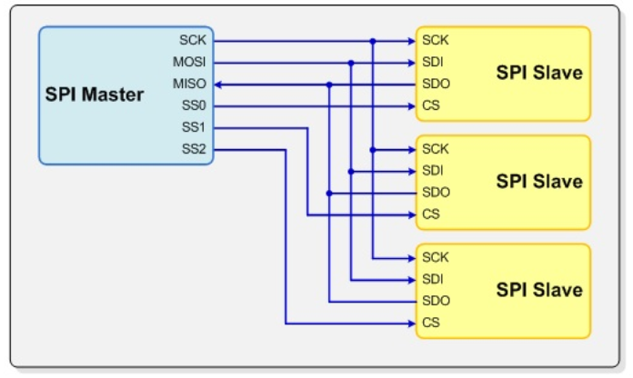
A single Master may control several Slave devices ( 1 at a time)
Slave select signals,
1 per slave
All slave devices share master’s SCK, MOSI, MISO signals.
Each slave device has it’s own SSn (functions as a chip select).
Tri-state SDO output on slaves mean they can all be connected without contention.
Master activates SSn to select slave device prior to data transfer.
Master generates a clock pulse for each bit transferred.
Shift registers in Master and Slave used to exchange data 1 bit at a time

Slide 6
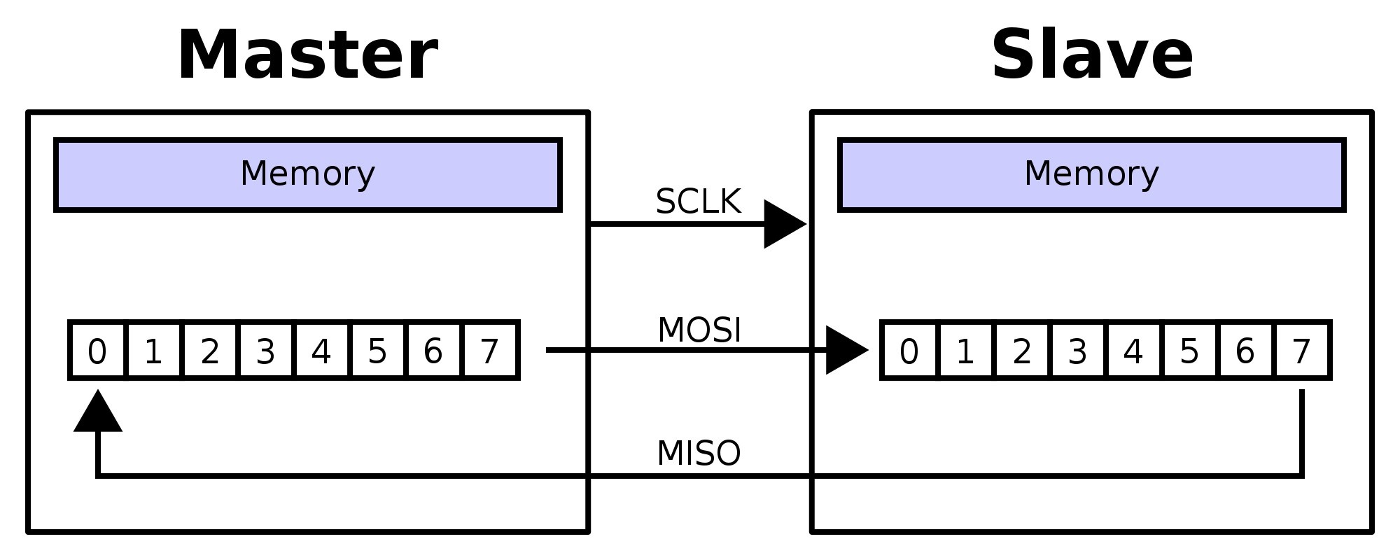
SPI devices use a “Circular Shift Register” to exchange data
During a Master Write, the Master pre-loads a shift register with 8 bits of data and then it is clocked out of the MOSI signal. Simultaneously, the enabled Slave will clock that data into it’s own shift register where it can be read.
At the same time, data from the slave shift register is also clocked out of the MISO signal and loaded into the master shift register where the master can read it.
IMPORTANT: In order to read a byte from a Slave (assuming the slave has loaded it’s shift register with the byte to be read), the Master has to write a dummy byte to the slave device.
Master shifts out data to Slave, and at the same time shifts data in from Slave

Slide 7
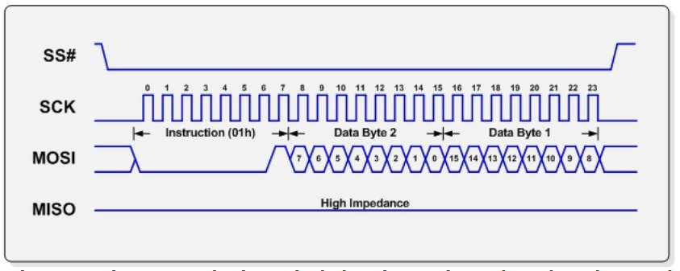


SPI Communication
Each slave device has a set of commands or instructions (see the data sheets for each slave) that define the protocol of information exchange e.g. read/write operations etc.
The master initially sends the command plus any additional data as a series of bytes.
The illustration below shows the master writing command 01 plus 2 bytes of data to a slave.
Slave devices that are not selected, tri-state their SDO (MISO signal) to avoid conflicts.
Important: The SSn signal is typically required to be negated at the end of each command so that the slave device can act upon it.
Master
Slave 0
SS₀
SCK
SCK
MOSI
SDI
MISO
SDO₀
SS
SS₀
SS
CS*
SS₁
Slave 1
SCK
SDI
SD0₁
SDO₁
SS
CS*
Slave 1 not selected so it tri-states its SDO output

Slide 8
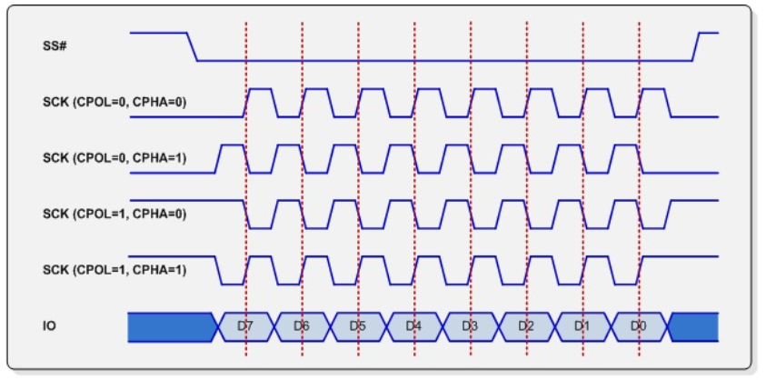
SPI Clocking Modes
Four possible clock phase and polarity operating modes.
Polarity indicates the idle state of the clock (‘0’ or ‘1’).
Phase indicates which clock edge (rising or falling) is used for shifting and which for loading.
Modes 0 and 3 most common (data loaded on rising edge, shifted on falling edge). Check which modes your slave device supports.
Master can change mode “on-the-fly” when talking to different slaves.
Slave device timing
Mode 0 : Idle = 0
load( clk )/shift ( clk )
Mode 1 : Idle = 0
load( clk )/shift ( clk )
Mode 2 : Idle = 1
load( clk )/shift ( clk )
Mode 3 : Idle = 1
load( clk )/shift ( clk )

Slide 9
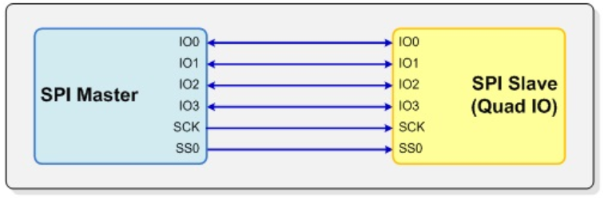
Quad IO Stream Devices
Many memory chip manufacturers are now producing Dual and Quad stream SPI devices which can, for example, offer up to 4 times the performance of a standard single stream device (at the expense of more wires/pins and more complex SPI master technology). These are generally backward compatible and can still operate as single stream devices.
Here the MISO/MOSI signals are bi-directional allowing 4 bits per clock to be transferred. Of course you need a Quad Stream Master to take advantage of it. These devices offer very fast Boot-to-Dram operation to load firmware at boot time.
This is the kind of memory used in USB memory sticks and SD-Cards

Slide 10
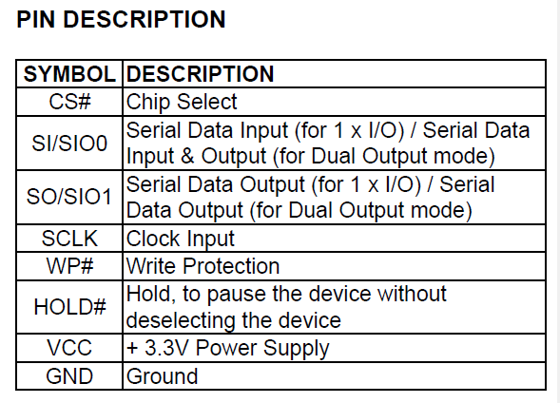
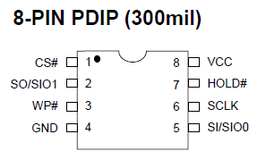
Example Micronix SPI Flash - MX25L4006E – 256kbyte device)
80Mhz Single + Dual stream SPI device.
Supports Mode 0 and Mode 3 Operation
2.7 to 3.6 Volt
Organised as 128 sectors of 4Kbytes or
8 blocks of 64k bytes
40mS sector erase time.
Page write of 256 bytes = 0.6ms (typ)
2uA Standby Current.
Commercial, Industrial and Automotive Temperature Ranges.
Chip Write Protection (WP#)
Block Write Protection (S/W)
100,000 Program/Erase Cycles.
>20 Year Data Retention.
Tie to logic 1 to allow data transfer
Tie to logic 0 to write protect
or logic 1 to allow writing

Slide 11
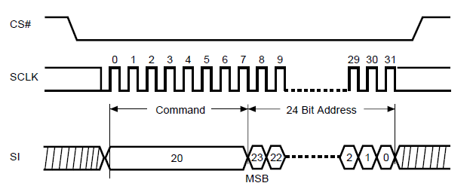
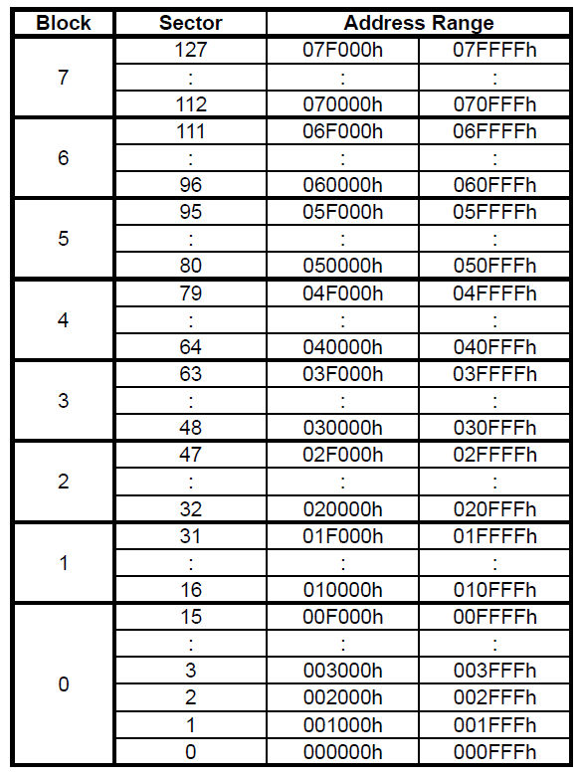
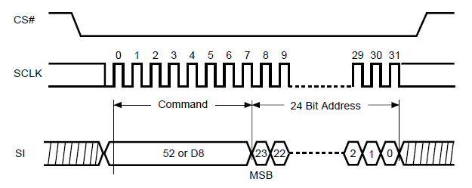
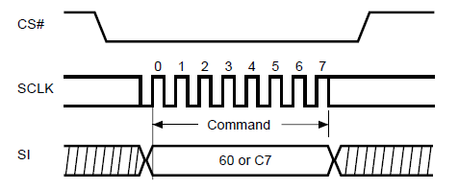
MX25L4006E - Internal Structure and Erase Protocol
Sector Erase
containing the address
Block Erase
containing the address
Chip Erase
Note : All signal names w.r.t. to Memory Chip

Slide 12
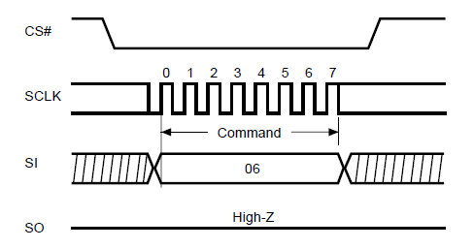
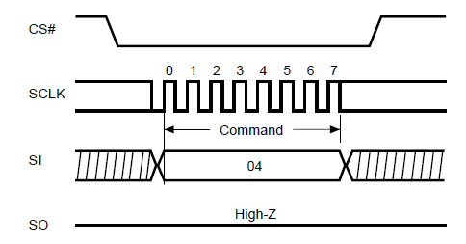
MX25L4006E – Write Enable/Disable
Write Enable: This has to be issued prior to the start of EACH command that intends to write to the device, e.g. data, erase sector/block/chip etc
After completion of the write command, the device returns to write disabled (as a safety mechanism)
This command sets bit 1 of the chip Status Register – see next slide
Write Disable: Prevent further writing until re-enabled. This command clears bit 1 of the chip Status Register – see next slide
Note : All signal names w.r.t. to Memory Chip

Slide 13
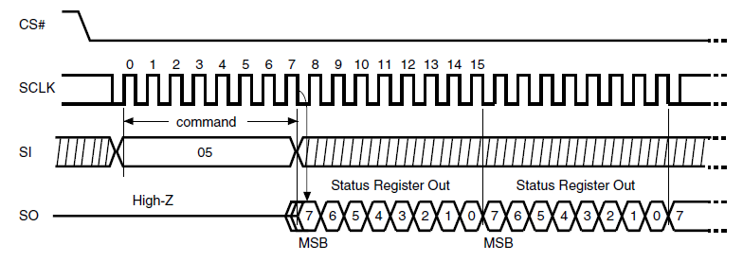
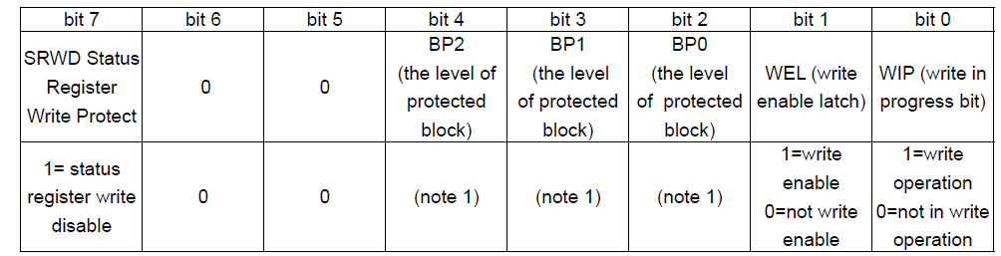
MX25L4006E – Reading the Status Register
Read Status Register
(continuous until CS# goes high)
Dummy write
Dummy write
Use to write protect Status Reg
(in conjunction with WP# pin)
ID of write protected block
Poll for write completion
Note : All signal names w.r.t. to Memory Chip

Slide 14
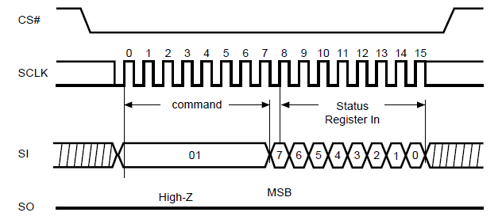
MX25L4006E – Writing to the Status Register
Write Status Register : Use this command to change the value of Block Protect (BP2, BP1, BP0) bits to define the protected area of memory.
This command can also be used to set or reset the Status Register Write Disable (SRWD) bit (bit 7) in conjunction with Write Protection (WP#) pin.
Note : All signal names w.r.t. to Memory Chip

Slide 15
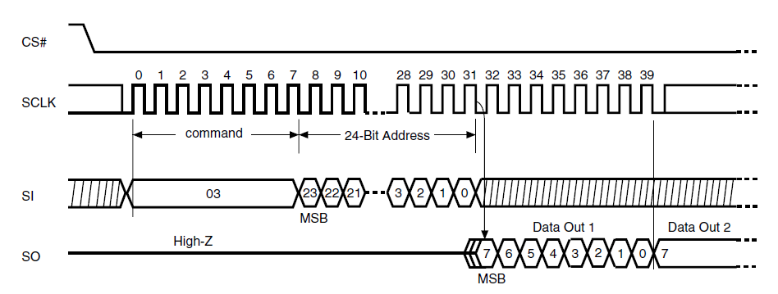
MX25L4006E Read Operation
Read data command (03)
Unlimited data can be read starting at the specified internal 24 bit address, until CS# (SS#) is negated.
Dummy write
Dummy write
Note : All signal names w.r.t. to Memory Chip

Slide 16
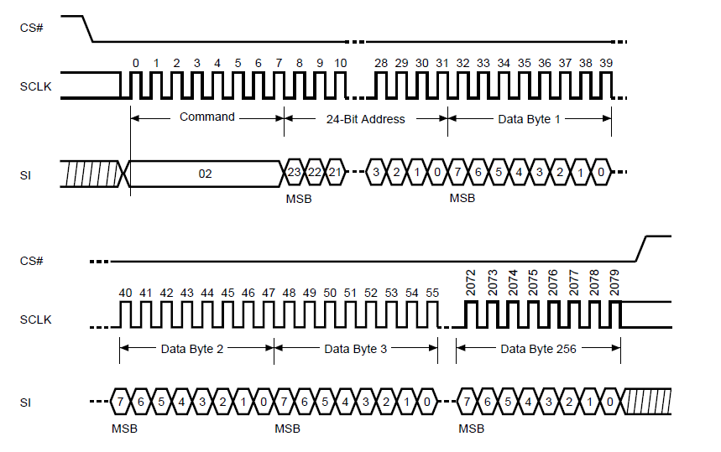
MX25L4006E Write Operation
Write Data/Page Program command (02). Up to 256 bytes can be written per write/program command starting at the specified internal 24 bit address. CS# (i.e. SS#) must be negated at the end of last byte transferred in order for write operation to commence internally.
Note : All signal names w.r.t. to Memory Chip

Slide 17
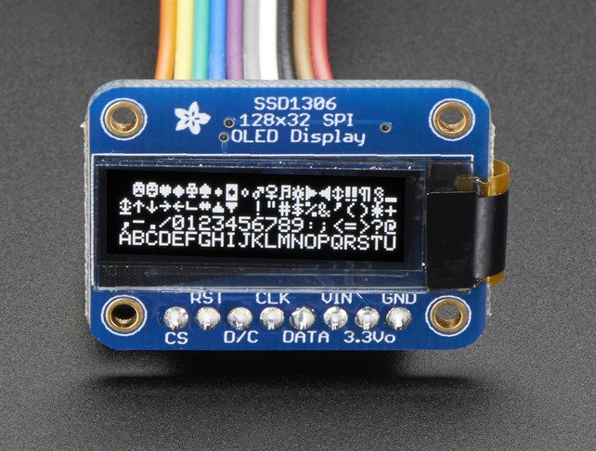
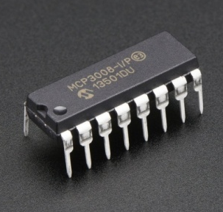
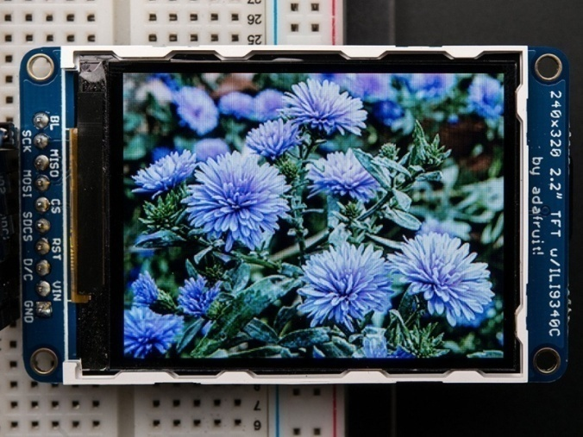
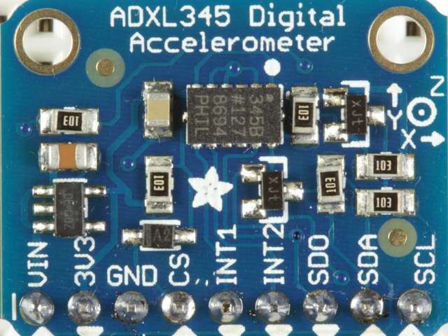
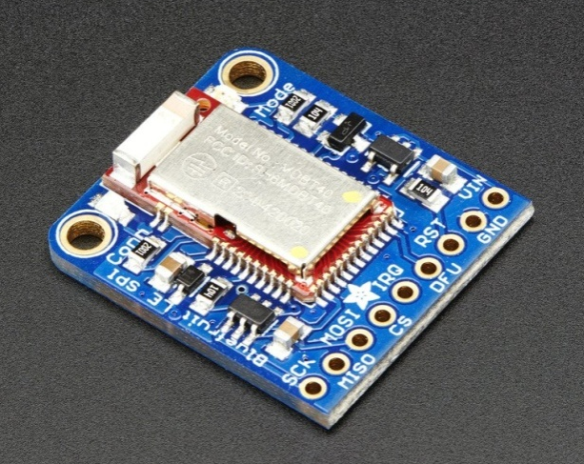
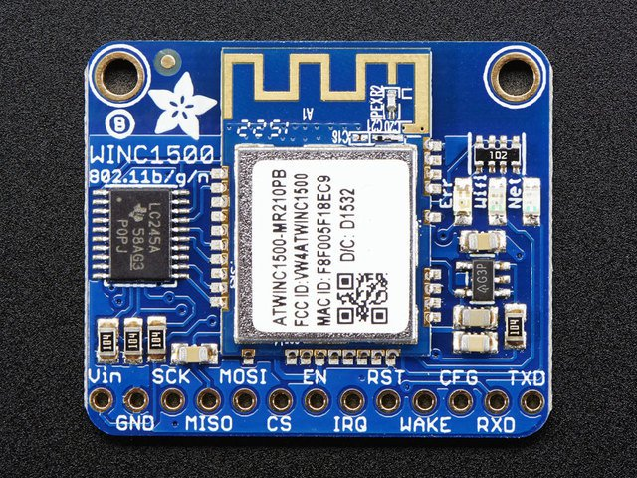
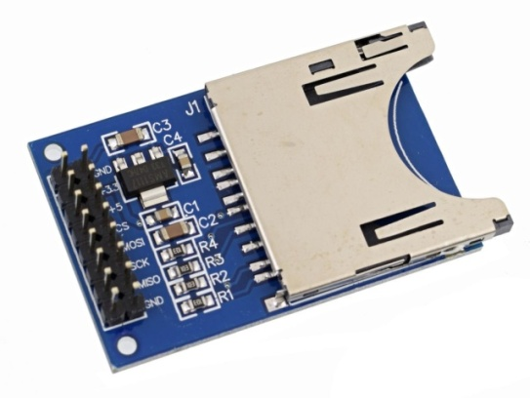
SPI bus devices and chips
Monochrome 128x32 SPI graphic display
10 bit (8channel)
SPI ADC @200ksps
SPI 3.5" 320x480 Color TFT with Touch screen
SPI and I²C bus 3-axis Accelerometer
WiFi module with SPI interface @ 12MBps
SPI Bluetooth Controller @ 4MBps
SPI based SD-Card Reader

